Slide 1
Session 10

Slide 2
Content of session
1
2
Assets Recap
3D
Collisions
3
4
Replacing Greyboxes
Environment & Lighting

Slide 3
1
Recap (Assets)

Slide 4
Assets
Most important materials :
Albedo: color using RGB and alpha for transparency.
Metallic: how metallic the surface is. (1 channel)
Roughness: how rough or smooth the surface is. (1 channel)
Ambient Occlusion: how much ambient light reaches the surface. (1 channel)
Normal Map: used to add details and depth to the surface.
Emission: how much the surface emits light form itself.

Slide 5
Assets use 1st method
Steps to use an asset in your project:
Open your asset file from your filesystem.
Check the material the model is using, then open it and properly set its texture.
Now the asset will display properly.

Slide 6
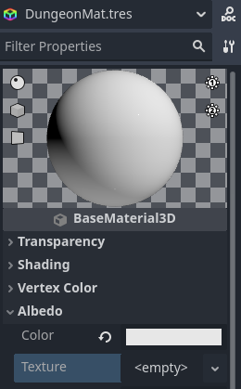

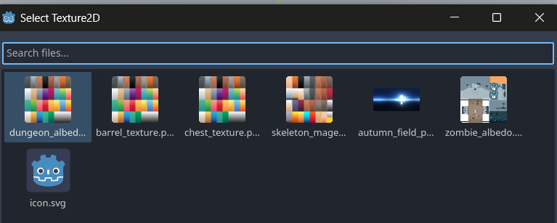
Assets use 1st method

Slide 7
Assets use 1st method
Steps to use an asset in your project:
Now make a new scene (set the scene root as whatever type you want).
Drag the asset into the scene tree.
Continue working on you project

Slide 8
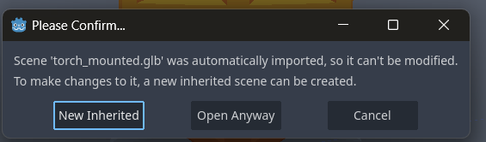

Assets use 2nd method
Steps to use an asset in your project:
Drop your asset file into your scene.
Click the scene icon next to the asset or right click then choose open in editor.
Then choose open inherited.

Slide 9
Assets use 2nd method
Steps to use an asset in your project:
This will open the asset as a new scene where you can freely edit your asset’s texture, materials etc.
Once you’re done, save the scene and go back to the main level scene.
Remove the original asset and replace it with your new “scene” asset.

Slide 10
2
3D Collisions

Slide 11
3D collision
3D collisions apply to physics bodies.
In your asset’s scene, add a physicsbody3d (ex. staticbody3d)
To generate your collision shape there are 2 options

Slide 12
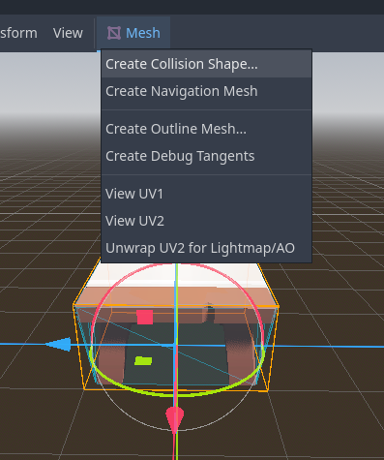
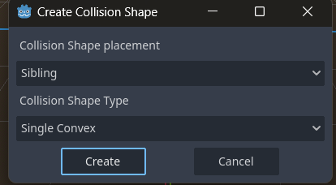
3D collision
Manually choose a collision shape and tweak it in the inspector
Or, when viewing the mesh, click on the mesh icon in the toolbox, and choose generate collision shape.

Slide 13
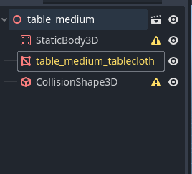
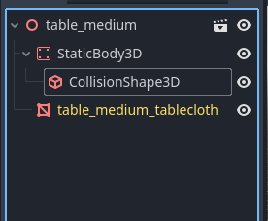
3D collision
This will generate a collisonshsape3D node in your scene tree under the mesh node.
Restructure your scene tree so that the collision shape is under the physicsbody3d node.
Error icons removed!

Slide 14
A Note about generating a collision shape from meshes

Slide 15
A Note
Choosing to generate a collision shape from the mesh, while it makes a (mostly) accurate shape, will often make it very detailed, which will introduce complexity to the physics rendering and doing this a lot throughout your game will cost you in performance. So do keep that in mind.

Slide 16
3
Replacing Greyboxes

Slide 17
Grey Boxing

Slide 18
Grey Boxing
CSG Nodes: a node that allow you to make a complex shapes by combining shapes like cubes, spheres and cylinders. You can use this to make a prototype for the level you want make.

Slide 19
Grey Boxing
Types of CSG Nodes:
CSGBox: a box shape.
CSGCylinder: a cylinder shape.
CSGSphere: a sphere shape.
CSGPolygon: a polygon shape.
CSGMesh: a mesh shape.
CSGTorus: a torus shape.
CSGCombiner: a node that combines multiple CSG nodes into one shape.

Slide 20
Replacing Grey Boxes
First off, we’ll give the CSGCombiner3D a new material so we can work comfortably.
Then we’ll enable Transparency in the material’s settings.
Lastly under Albdeo, we’ll choose the color of our choice and set the A (alpha) channel to a lower value so the greybox goes transparent.

Slide 21
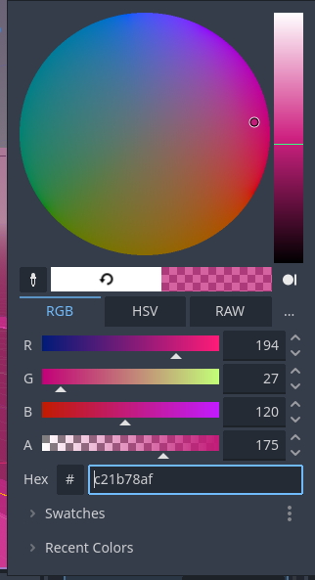
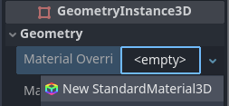

Replacing Grey Boxes

Slide 22
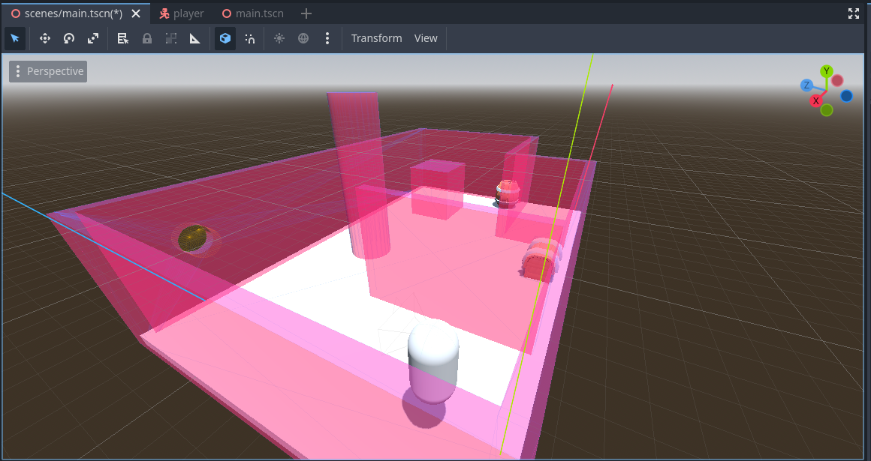
Ta-Da!

Slide 23
Replacing Grey Boxes
To put the actual map assets, we need to make sure each one is in a scene of its own with collision shapes, the root node being an appropriate PhysicsObject node (e.g. StaticBody3D).
(Refer to the previous assets section in slides.)

Slide 24
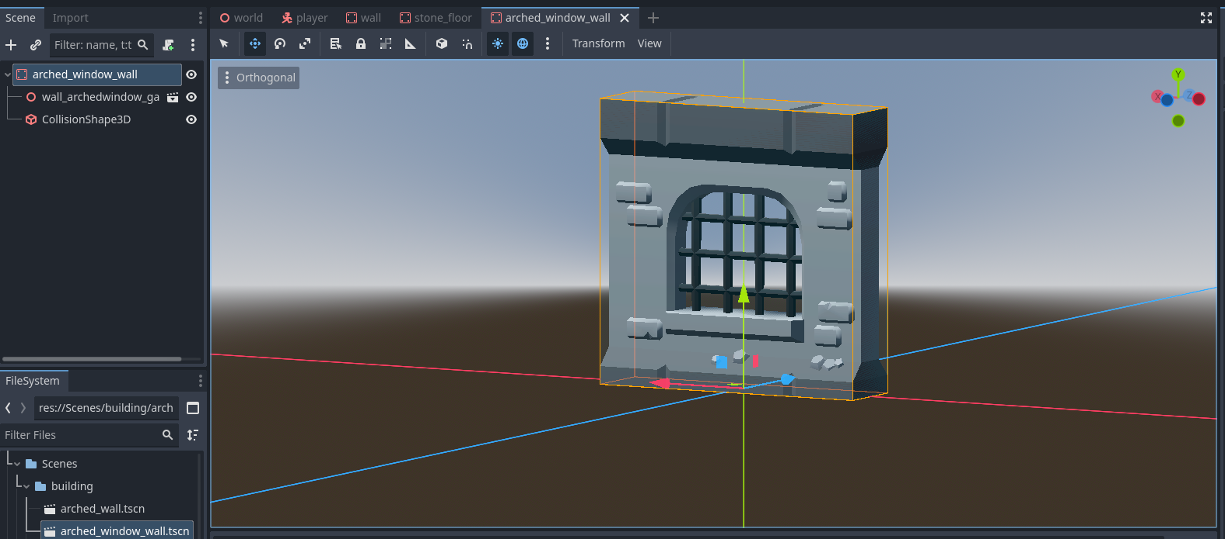
Replacing Grey Boxes

Slide 25
Hands on

Slide 26
4
Environment & Lighting

Slide 27
Environment
The Environment is – quite literally – what sets the environment for the game.
It lets us set things like ambient lighting, sky colpurs and horizons, add specifcs options like fog and reflections and more!

Slide 28
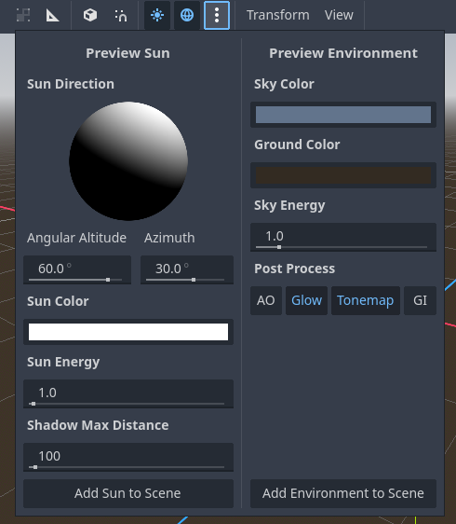
Environment
To add an environment: you can click on the 3 dots in the the toolbar, or add it manually as a node in your scene.

Slide 29
Environment
The Environment node has a lot of settings in the inspector, mainly:
Background: Let us choose the background or sky
Sky: configure sky settings
Ambient Lighting: light that affects all object in scene.
Reflected Light
Tonemap
Fog/Volumetric Fog
And more

Slide 30
Environment
The Environment node has a lot of settings in the inspector, mainly:
Background: Let us choose the background or sky
Sky: configure sky settings
Ambient Lighting: light that affects all object in scene.
Reflected Light
Tonemap
Fog/Volumetric Fog
And more

Slide 31
Environment
There are 3 types of sky resources:
PanoramaSkyMaterial
ProceduralSkyMaterial
PhysicalSkyMaterial
PanoramaSkyMaterial lets us use a texture to fill out the skybox with.
ProceduralSkyMaterial lets us set a lot of details ourselves for the skybox.

Slide 32
Lighting
In 3D there are 3 main light sources:
DirectionalLight3D
OmniLight3D
SpotLight3D

Slide 33
Thanks!
Any Questions

